Slide 1

Louis Zimmermann, Emilia Blättel, Anna Huttner

Slide 2
Syntax
C++ has a complex syntax, especially when dealing with low-level operations and memory management. It has a broad range of features and supports both procedural and object-oriented programming.

Slide 3
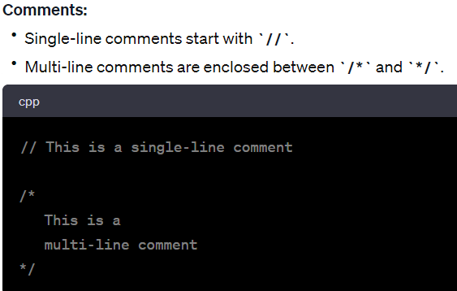
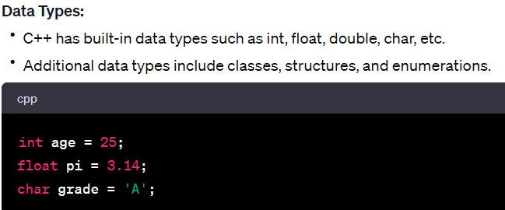

Slide 4
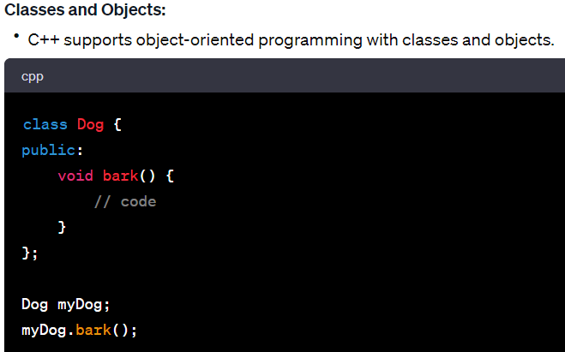
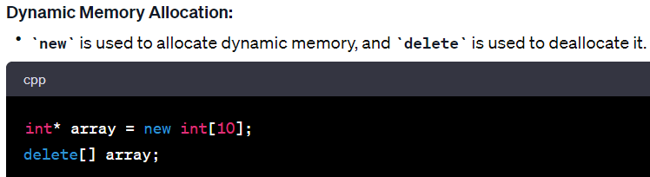

Slide 5
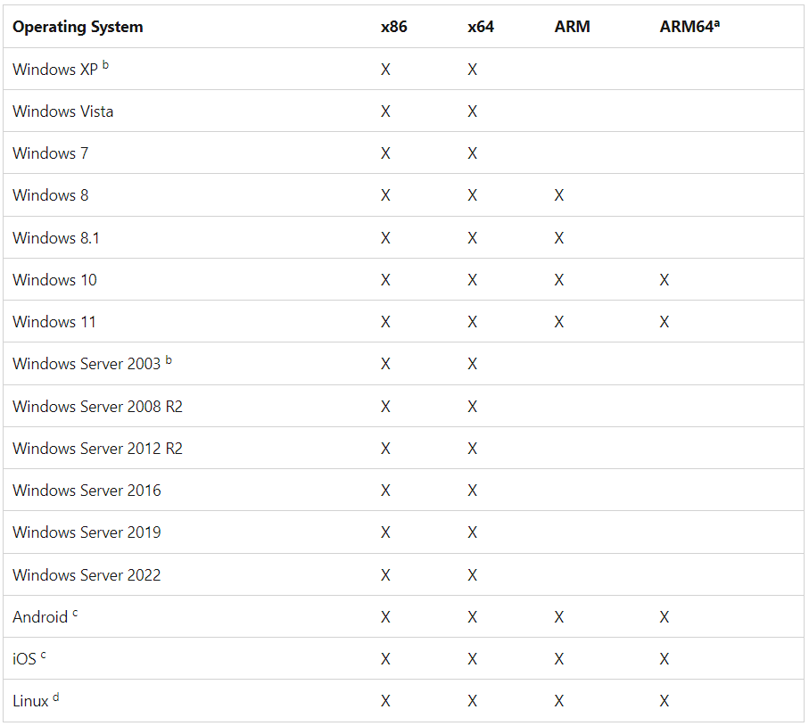
Support

Slide 6
Learning Curve
C++ has a steeper learning curve due to its complexity and low-level features.
Can be overwhelming for beginners
With no prior experience, you should expect it to take at least three months to learn the basics

Slide 7

Industry Adoption
System Programming
Embedded Systems
Game development
High-performance Computing
Applications requiring substancial computational power
Banking Applications

Slide 8
Performance
Known for ist relatibely high performance
Low-level Features: fine-grained control over system
Development speed
Ease of maintenence
Availability of libraries
Close to hardware: Faster

